Slide 1
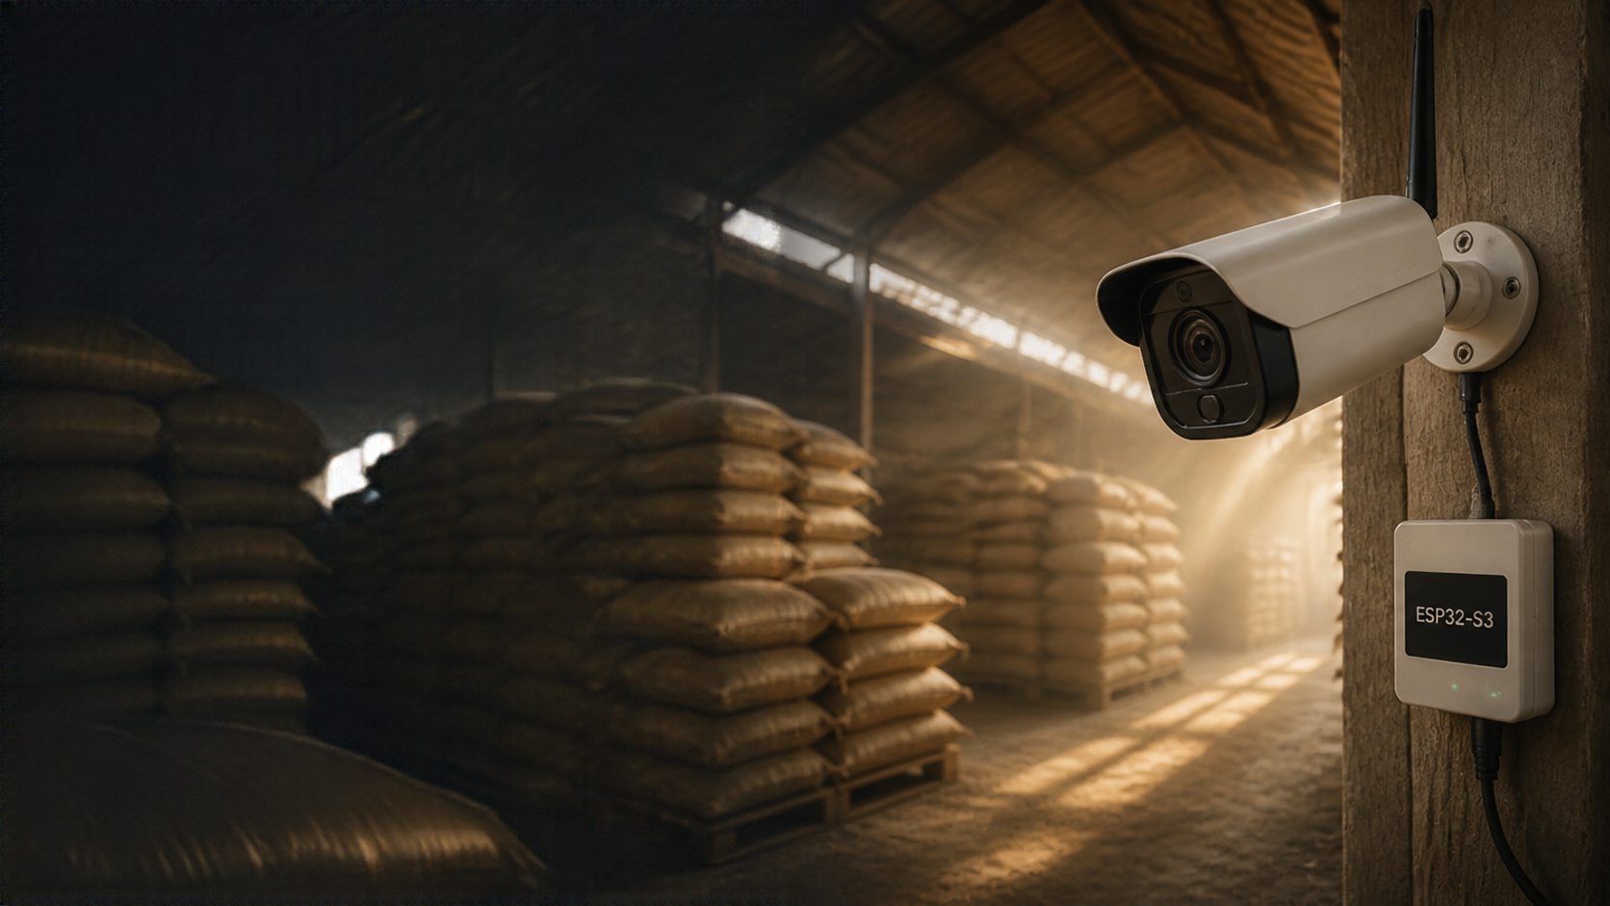
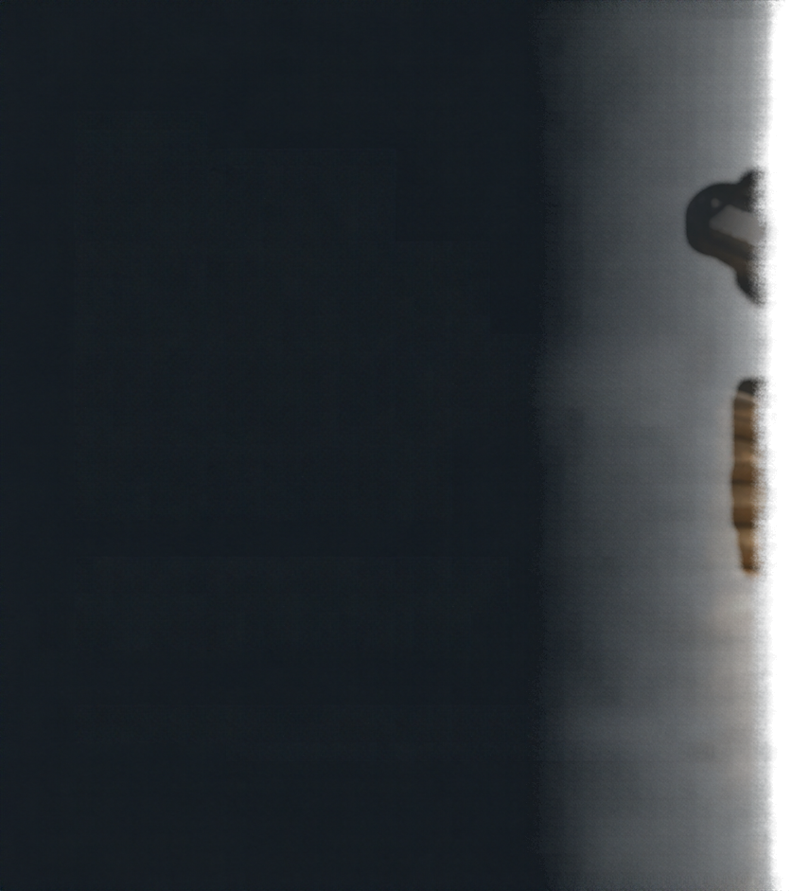

SMART
CAMERA
MONITORING
SYSTEM
Event-triggered monitoring
for dusty environments
ESP32-S3
software prototype overview

Slide 2




PROJECT OBJECTIVE
Reduce repetitive human monitoring of rice barns
Detect motion automatically using PIR sensor
Avoid unnecessary continuous monitoring to save resources
Generate camera activation requests only on motion events
Designed specifically for
dusty rice-storage environments

Slide 3
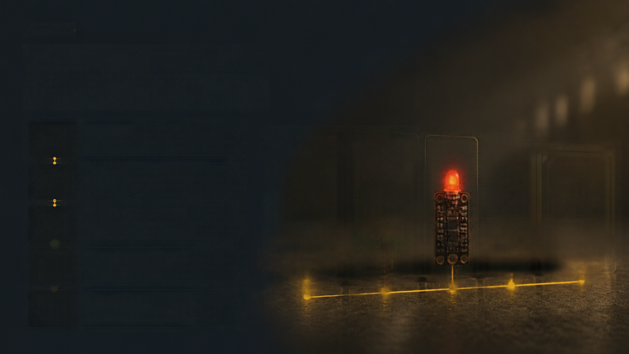


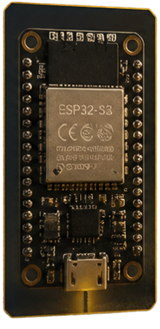
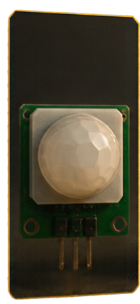
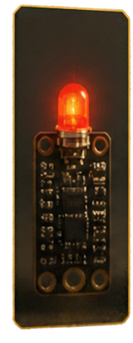
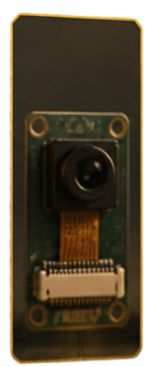
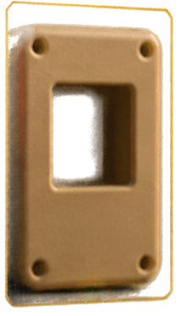

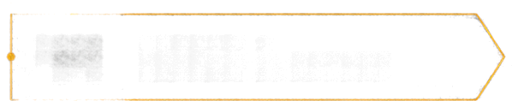

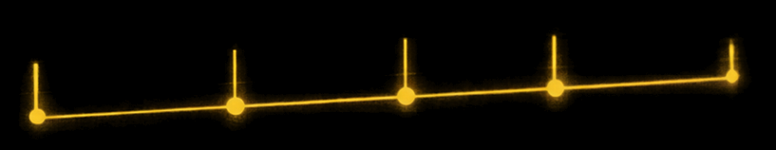
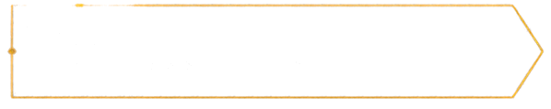
SYSTEM ARCHITECTURE
01
ESP32-S3
main controller
02
HC-SR501
PIR motion sensor
03
LED indicator
signals camera activation
04
Planned camera module
for image capture
05
Proposed dust-protection
enclosure (concept stage)

Slide 4

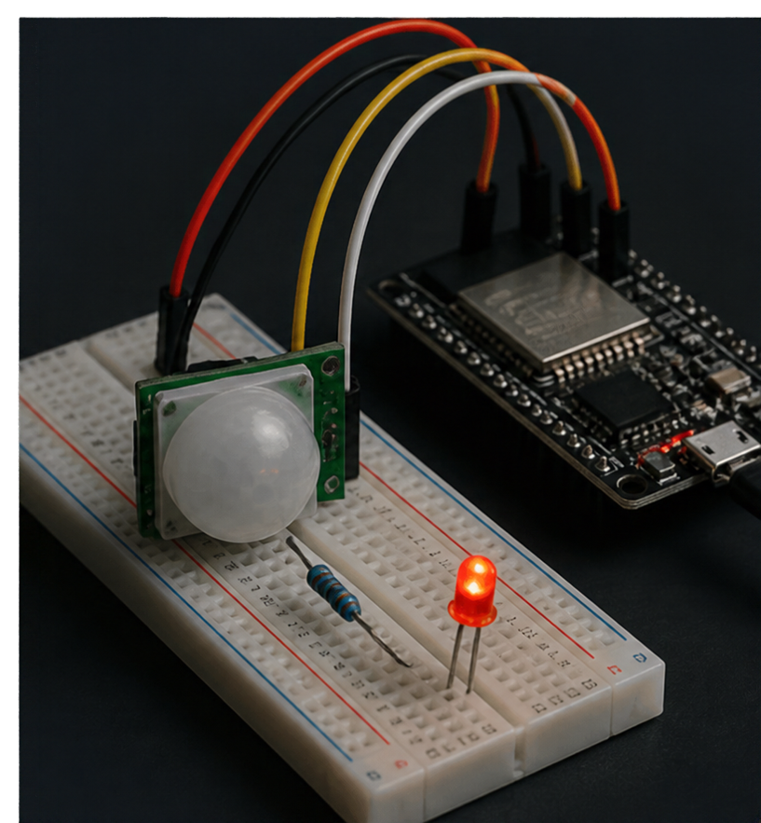





HARDWARE CONNECTIONS
PIR sensor VCC
5V
PIR sensor GND
GND
PIR sensor OUT
GPIO 4
LED control
GPIO 5
through 220 Ω resistor

Slide 5
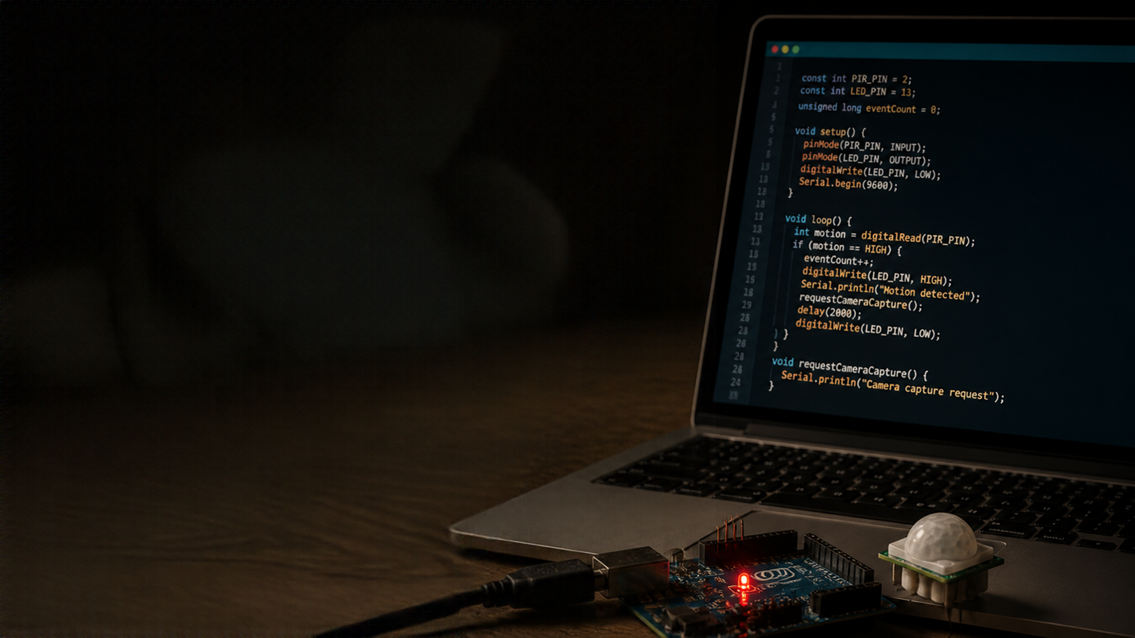




FIRMWARE
DEVELOPMENT
Developed in wokwi
Configured GPIO pins for PIR input and LED output
Monitors PIR sensor for
motion detection events
Maintains event counter to
track motion occurrences
Activates LED during motion event and deactivates after
Simulates camera capture request upon motion detection

Slide 6

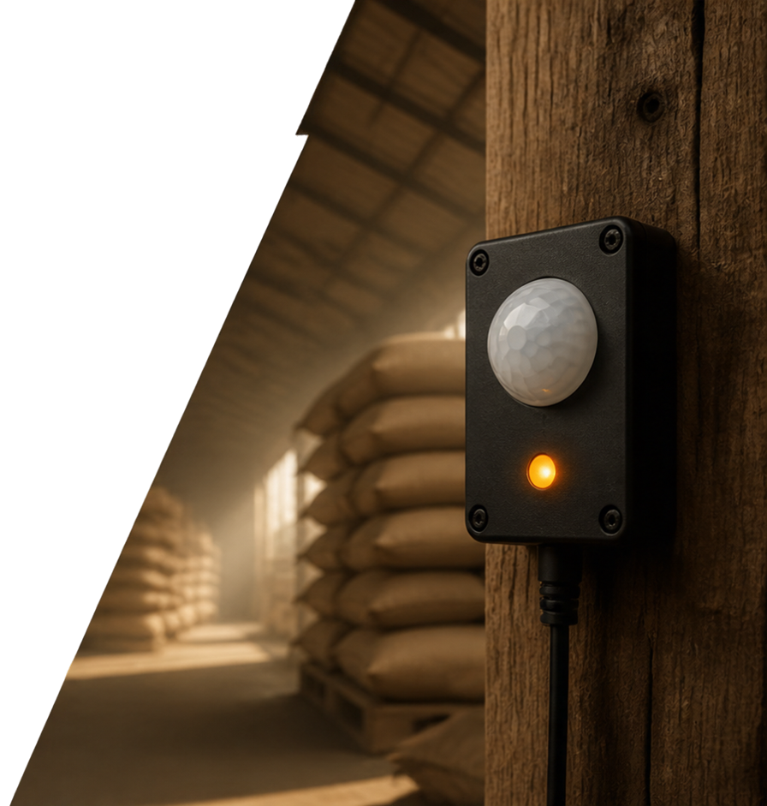
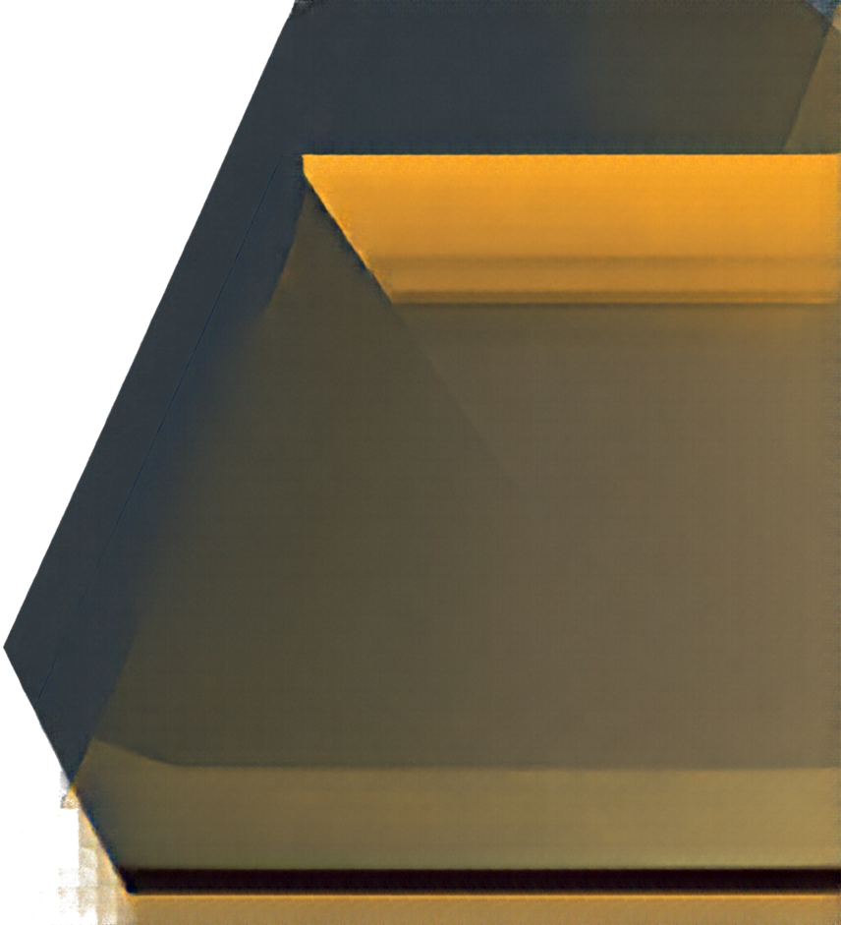


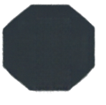



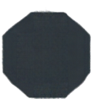

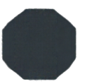

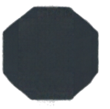

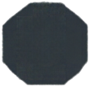
WORKING FLOW
1
System starts and initializes
2
ESP32-S3 monitors PIR sensor input continuously
3
Motion detected triggers event
count increment
4
LED switches ON indicating
camera activation request
5
Motion stops, LED switches OFF
6
System resumes monitoring
for next event

Slide 7
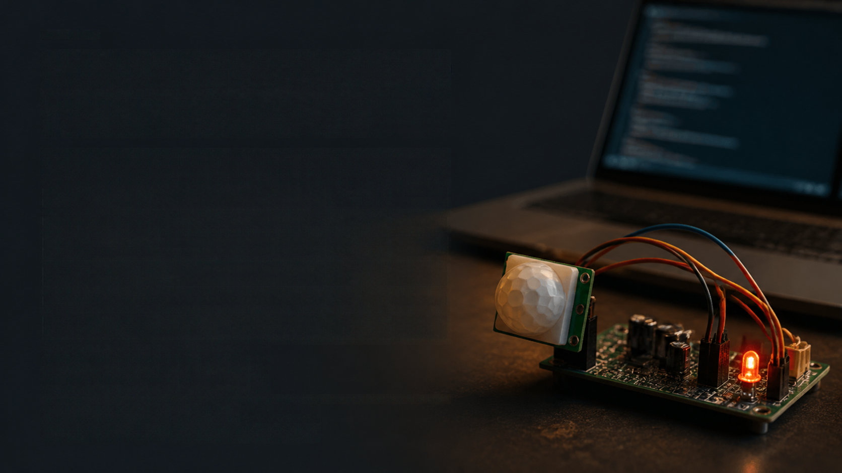



SIMULATION AND TEST RESULTS
TEST
RESULT
Serial startup
Pass
PIR detection
Pass
LED activation
Pass
LED deactivation
Pass
Event counting
Pass
Camera request simulation
Pass
Four complete motion events
verified during integration testing
Event counter later reached
event number 5 during extended testing

Slide 8


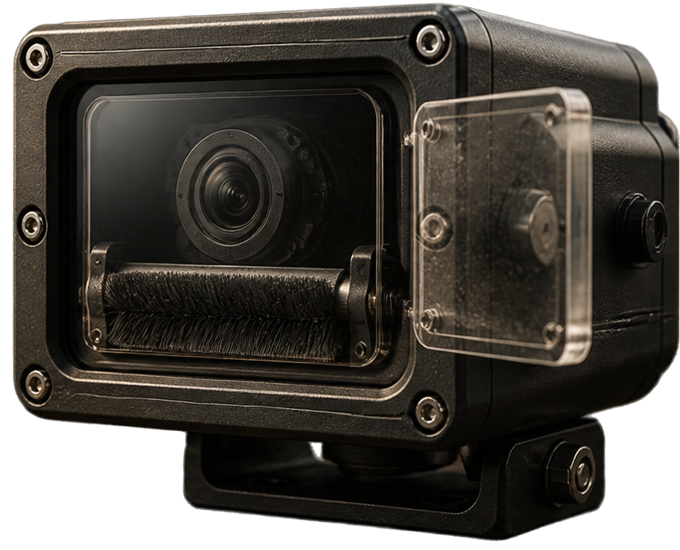
DUST PROTECTION CONCEPT
Enclosed camera housing with clear protective window
Removable cleaning window for easy maintenance
Integrated soft-brush mechanism to keep the window clean
Concept only; not tested as a physical prototype

Slide 9


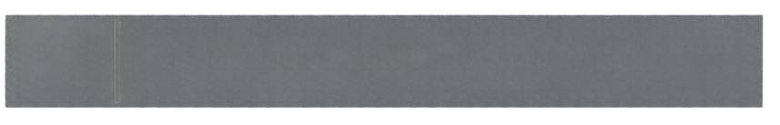
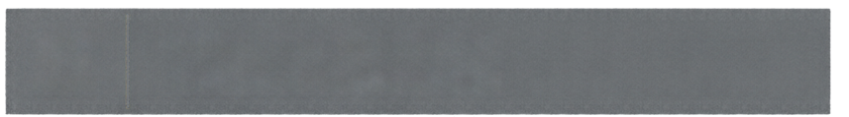
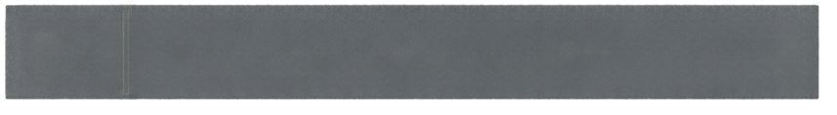

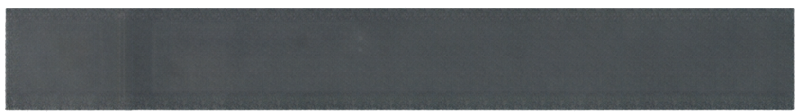
DEVELOPMENT TOOLS AND
GITHUB REPOSITORY
01
Visual Studio Code IDE for coding
02
Wokwi online simulator
for ESP32-S3 DevKitC-1
03
Firmware written in Arduino C++
04
Version control with Git
and project hosted on GitHub
05
Repository URL:
https://github.com/hannejesse/smartCamera-monitoring

Slide 10



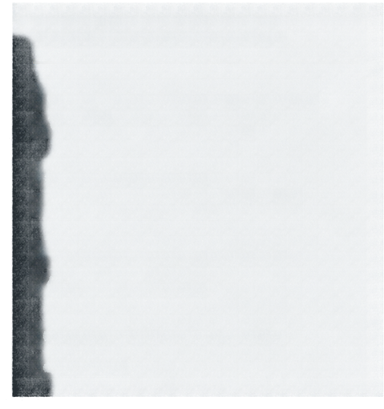




CONCLUSION AND FUTURE WORK
WHAT WE ACHIEVED
WHAT'S NEXT
ESP32-S3 firmware prototype
with PIR event detection
Raspberry Pi 5 prototype development
Actual camera integration for
image capture and storage
LED activation and
event counting functionality
Physical hardware testing in
rice-barn environment
Successful simulation and
integration testing
Building and testing
dust-protection enclosure
Documentation and code
on GitHub
Comparative analysis between ESP32-S3 and Raspberry Pi 5 platforms
This presentation covers the first prototype only; a final presentation will combine results from both platforms.

